Slide 1
Lecture 01
Ms Zahra Ali

Slide 2
What is Object??
Instructor takes attendance. Instructor has ID and name. Attendance would have some details e.g. Semester, Course name, section, Participant name Date and time and status(P,A L) of student.

Slide 3
What is Object??
Instructor takes on attendance sheet. Instructor has ID and name. Attendance would have some details e.g. Semester, Course name, section, Participant name Date and time and status(P,A L) of student.

Slide 4
What is Object??
Instructor takes on attendance sheet. Instructor has ID and name. Attendance would have some details e.g. Semester, Course name, section, Participant name Date and time and status(P,A L) of student.

Slide 5
What is Object??
Objects and Properties
Instructor (Ins_name,Ins_ID)
attendsheet(Sheet_id,Status,DATE,Time,Day)
Semester(Sem_ID,Sem_name)
Discipline(Dis_id,Dis_name)
Course(Course_id, Course_name)
Participant(P_ID,P_name)

Slide 6
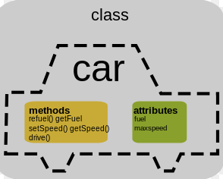
Class

Slide 7
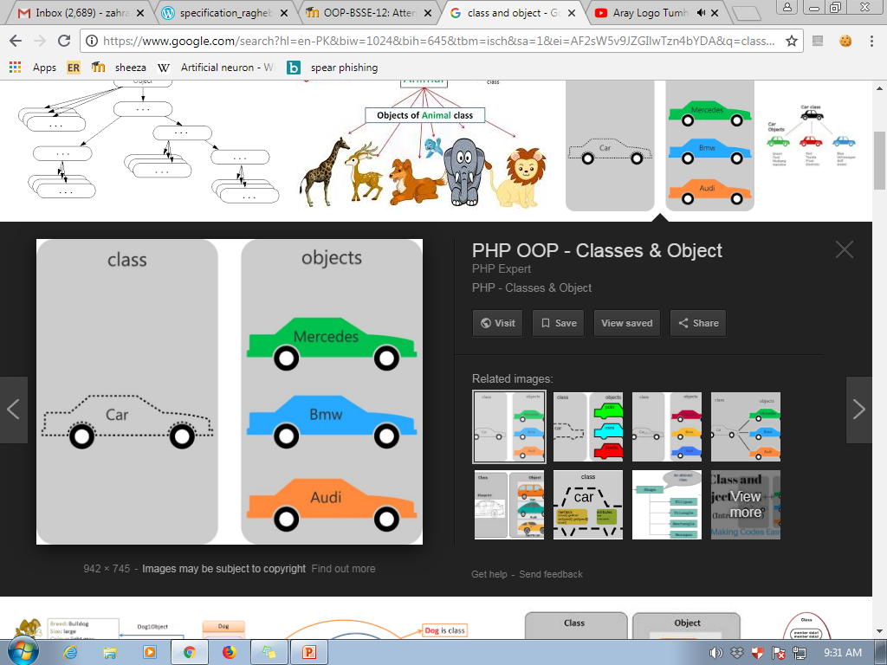
Difference Between Class and Object

Slide 8
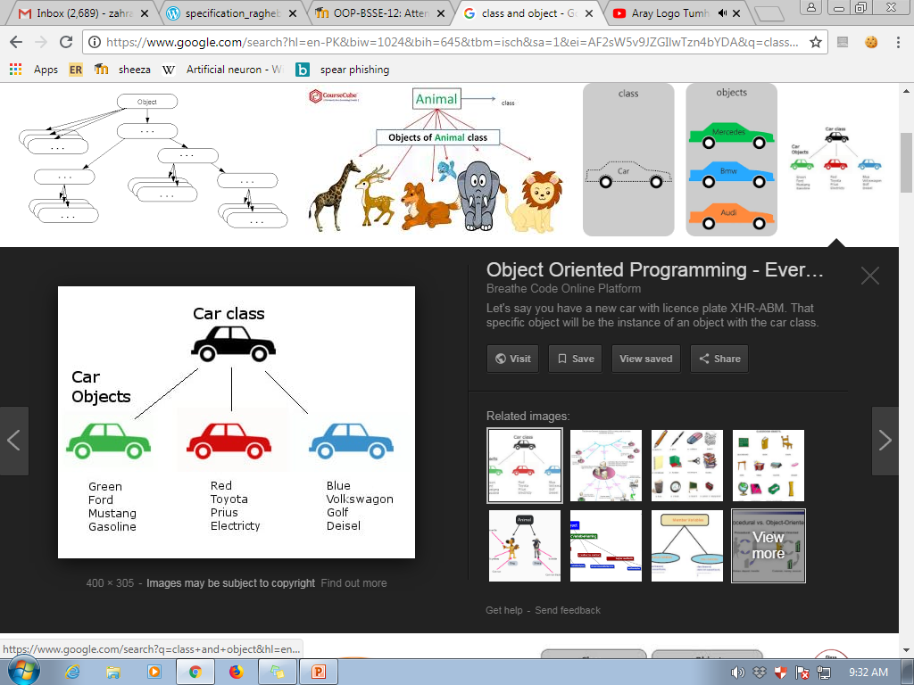
Difference Between Class and Object

Slide 9
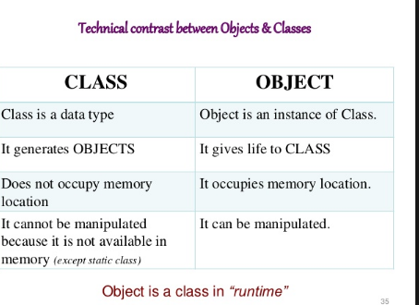

Slide 10
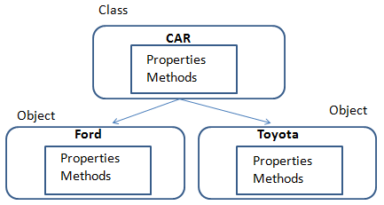
Class and Object

Slide 11
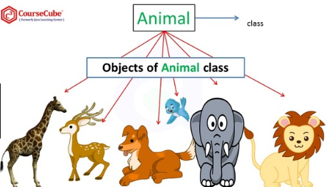

Slide 12
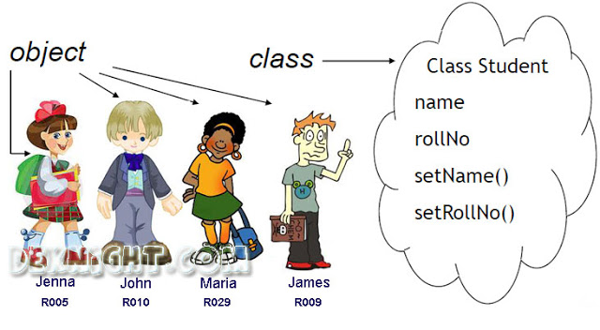

Slide 13
Class in C++
class car
{
int car_model;
char car_name;
public:
void get_cardetails();
void setcar_details(int a,char b);
};

Slide 14
Class in C++
void car::get_cardetails()
{
cout<<car_model<<car_name;
}
void car::setcar_details(int a,char b)
{
car_model=a;
car_name=b;
}

Slide 15
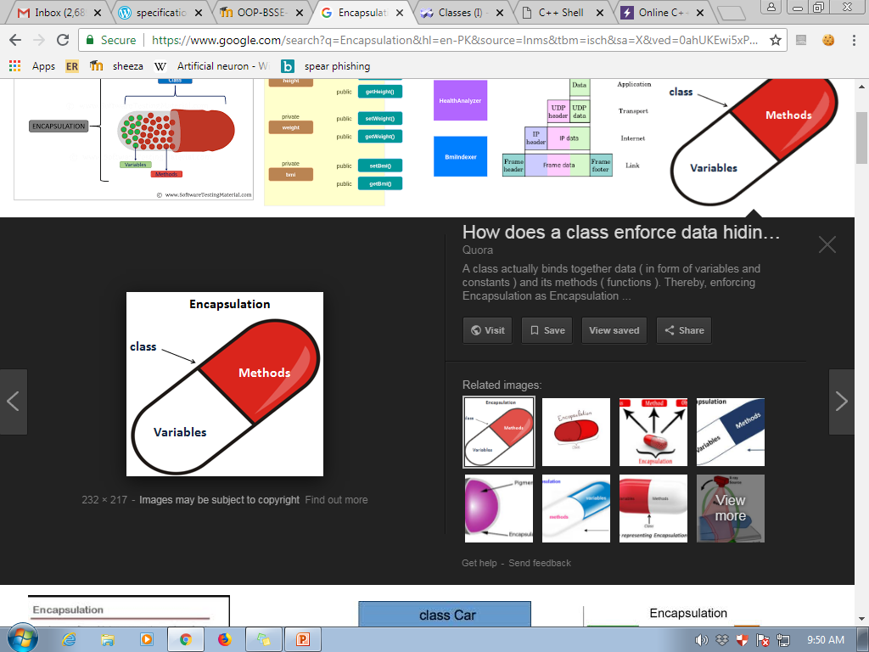
Encapsulation Concept

Slide 16
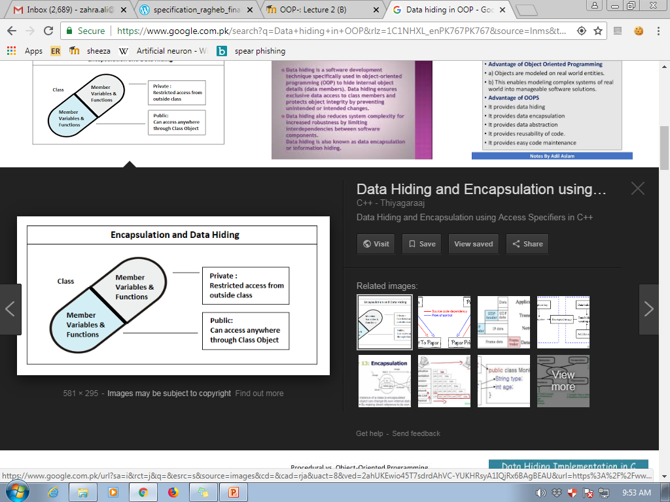
Data Hiding in OOP

Slide 17
Access Modifiers
Three types of Access Modifiers:
private:
public:
protected:
The scope of an access modifier continues until another access modifier is mentioned explicitly
There is a colon after every access modifier

Slide 18
Public vs Private
Public
Data or functions are visible
class car{
public:
car_color;
};
Car honda_city;
Honda_city.car_color = “RED”;
Private
Data or functions are invisible
class car{
private:
car_color;
};
Car honda_city;
Honda_city.car_color = “RED”;

Slide 19
Public
Public members can be accessed by member functions as well as by functions that declare the objects of that class.
Normally, for classes, those member functions are made public which must interact with the outside world.

Slide 20
Private
Private members can only be accessed by member functions.
This means they can only be accessed in the member function body.
Remember the ‘members’ mean both variables and functions.
By default all class members are private, unless declared otherwise.

Slide 21
Public or Private
It is not compulsory for all members functions to be public and all data members to be private.
Some member functions can also be private.
Similarly, data members can also be public.
Violation of Encapsulation principle

Slide 22
Member Functions
Class Sedan
{ private:
string model_name ;
string color;
public:
void get_car_info ();
int get_current_speed();
};
void Sedan::get_car_info()
{
[function code]
}
void Sedan::get_current_speed()
{
[function code]
}

Slide 23
Passing values in a Member function
class part
{
private:
int modelnumber; //Model Number
int partnumber; //Part Number
float cost; //Cost of Part
public:
void setpart(int mn, int pn, float c)
{
modelnumber = mn;
partnumber = pn;
cost = c;
}
};

Slide 24
Brainstorming
We are aware of services Careem or uber. By keeping in mind all the system process
Identify Careem system Objects
Make classes and identify the properties related to those class.
Identify which classes would be Public or private.

